Slide 1
OXFORD DATA SCIENCE PRE-INTERVIEW TASK: SAS RESULTS
Kristiana Dhillon
Feb 20, 2022

Slide 2
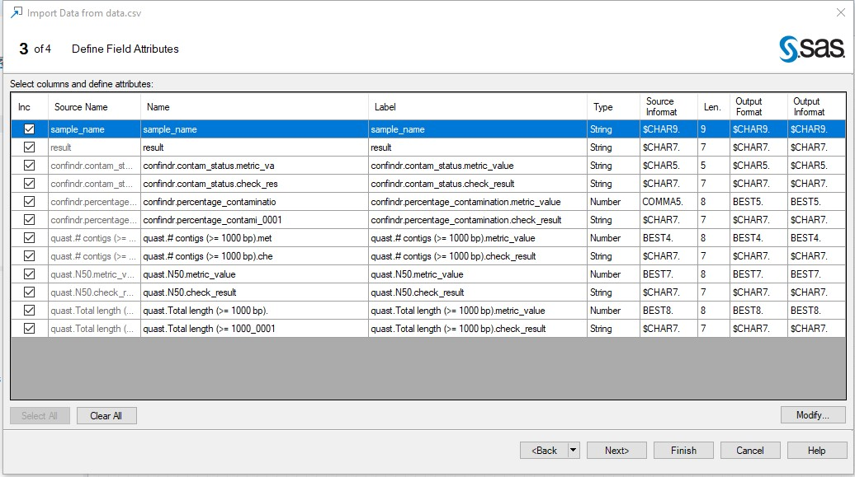
CSV Import:

Slide 3
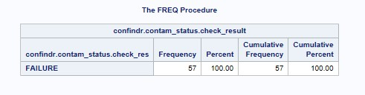
Question 1:

Slide 4
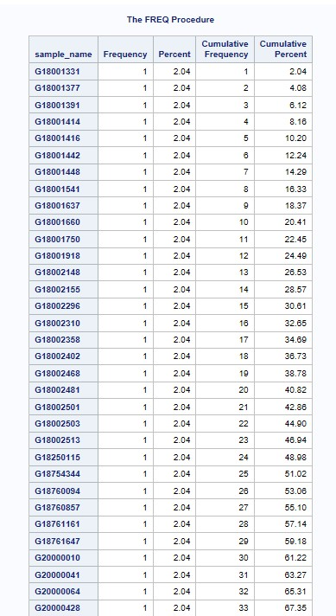
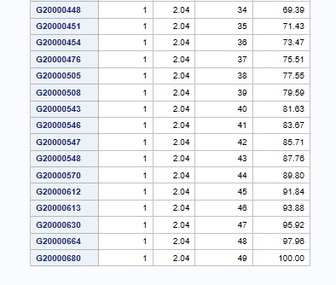
Question 2:

Slide 5
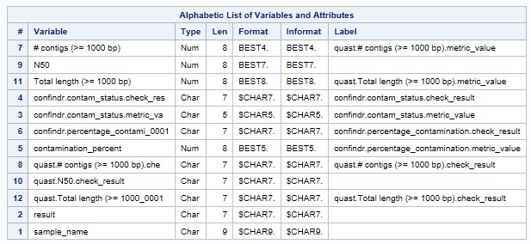
Question 3:

Slide 6
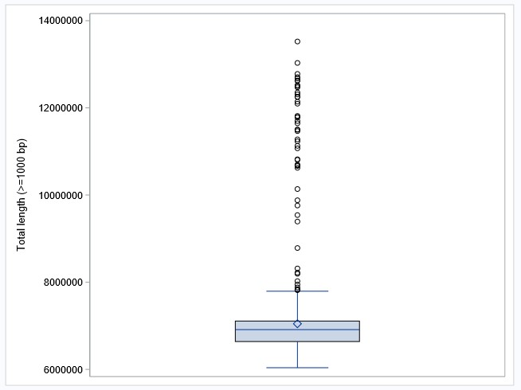
Question 4:

Slide 7
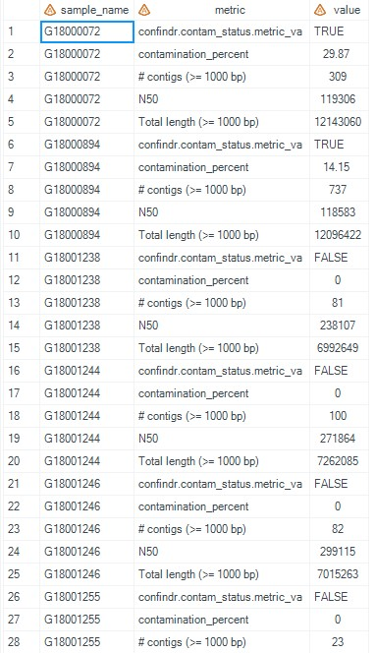
Question 5:

Slide 8
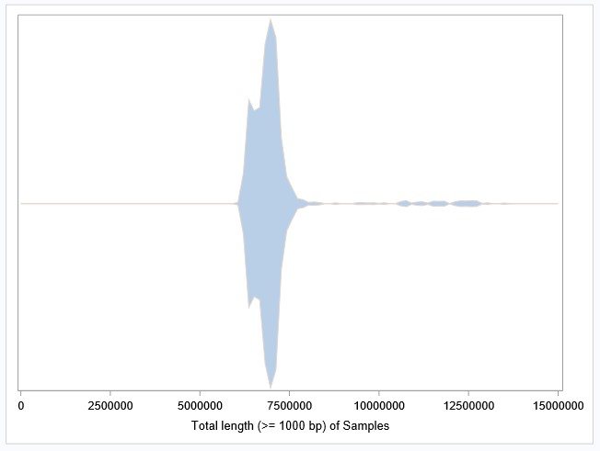
Question 6:

